Slide 1
PetMatcher: The Final Product Madison Wikoff, Devin Mason, Najja Price https://github.com/madisonwikoff/CSC102Project/tree/main

Slide 2
Our Goals—did we meet them?
OUR ORIGINAL GOALS
Overall - Make adding a new pet to one’s life easier and help people develop into more responsible pet owners.
Part 1 - Allow users to take a quiz that will match them to the ideal type of pet for their lifestyle.
Part 2 - Let users browse through a SQLite3 database of suggested essential items for their pet type.
Part 3 - Give users the ability to design their own personalized routine for them and their pet type, with built-in, color-coded, visual alarms for each task in their routine that light up at the time specified by the user for said task.
WHAT WE ACCOMPLISHED
We successfully implemented parts 1 and 3, as well as our overall goal. Our vision for part 2, however, had to change as we ran into unforeseen issues while trying to implement the SQLite3 database. To accommodate this problem, we adjusted it to be different GUI windows for each pet type with their specified list of suggested essential items. Aside from this, our product is exactly as we hoped it would be.

Slide 3
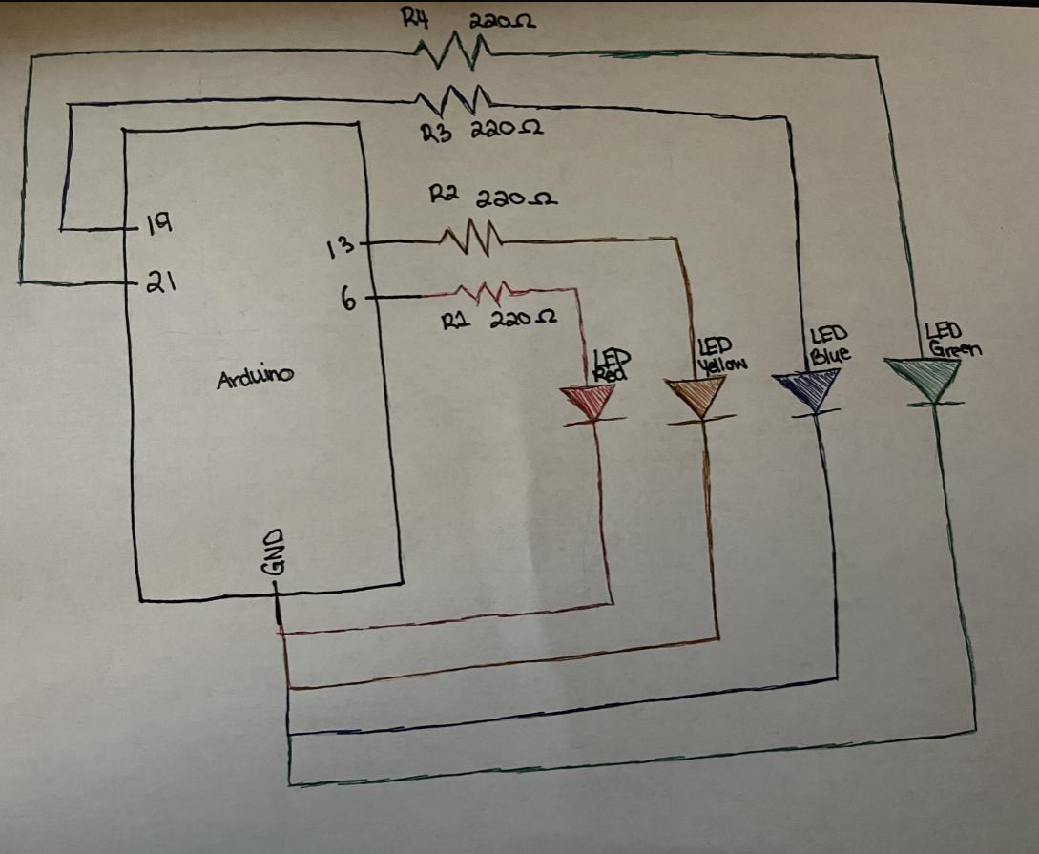
Our Use of GPIO
Different colored LEDs that signify each different type of task (ex. a blue LED signifies that it’s time to play with the pet)
User enter times in an “hour:minute:second AM/PM” format
Program tracks the system’s clock upon clicking the “Start Day” button
When current hour, minute, and period match the time that the user input in their routine, corresponding LED blinks as a visual alarm to signify to the owner that it’s time for a specific task to be completed. It will blink for that minute.

Slide 4
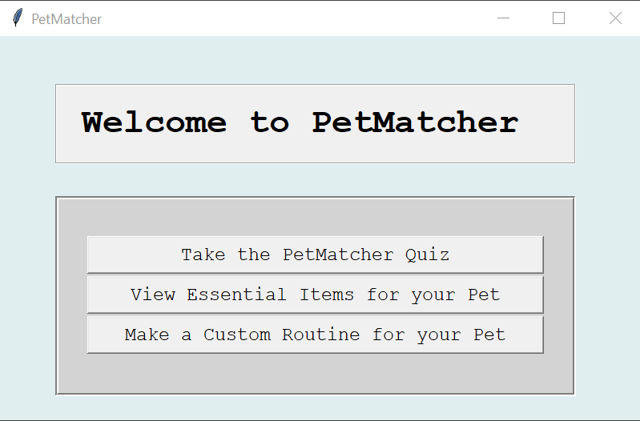
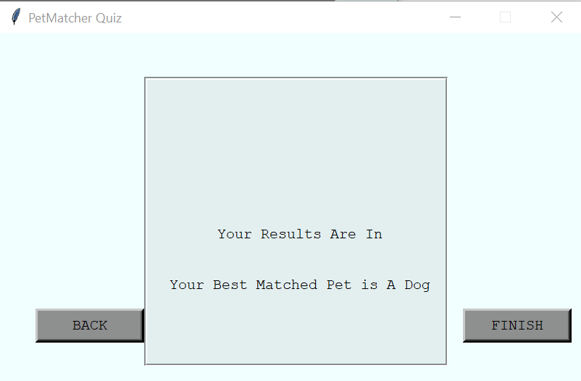
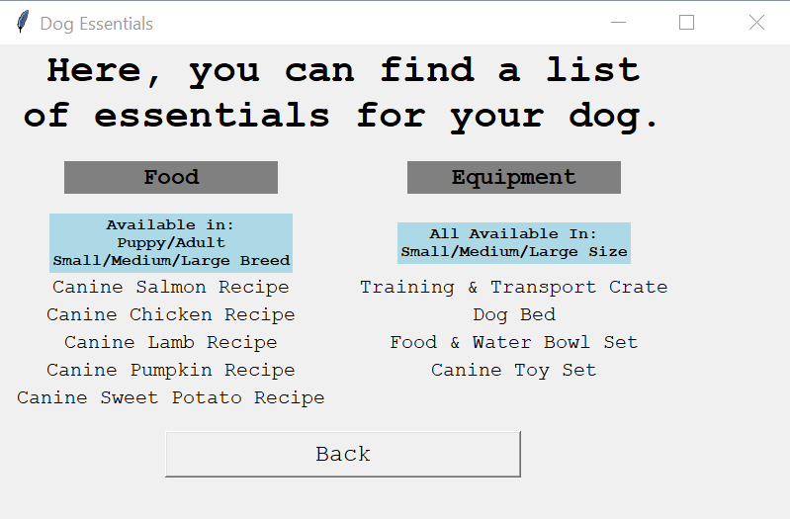
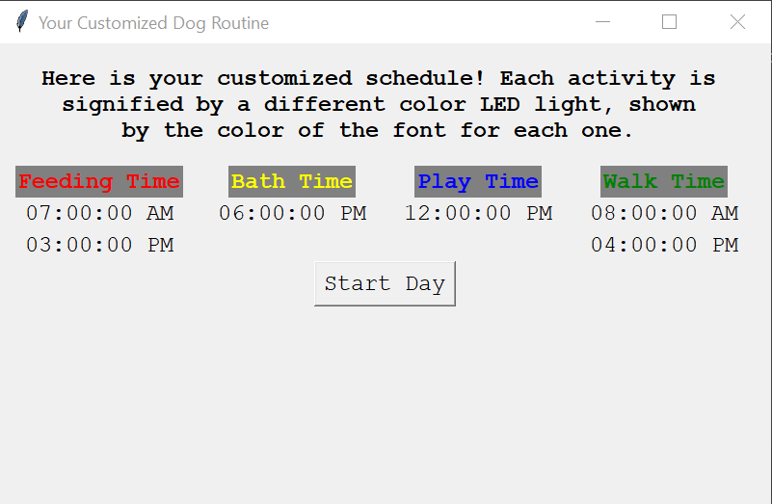
Our Use of GUI
Entire PetMatcher application operates on a graphic user interface created in Python through many different, unique functions that set up each window.
The first window is a homepage with three buttons for each section of our program.
One takes the user to our PetMatcher quiz.
Second takes the user to a page where they select the pet type and can view lists of pet type-specific essentials.
Third takes the user to another pet type selection page and can then make their own customized routines. Every window has its own unique function that makes it run.

Slide 5
Lessons We Learned
We Have Limits.
It is okay to acknowledge that changes have to be made, even if the change makes the end product simpler than we were hoping, in order to get the program working as we want or need.
Play to Our Strengths.
Each team member can play into their strengths, even if we might not be able to make use of everything brought to the table.
A major example of this for us was trying to get Najja’s designs that he made for us to appear properly on the GUI when running the program on the Pi. The Pi had other ideas.
Overall
Be patient with yourself and with your team when developing a program.
We all had to take things we have learned throughout CSC 101 and CSC 102 and expand on them with our own research in order to accomplish what we did, especially regarding the creation of the Quiz and how to code a properly functioning GUI with multiple windows.

Slide 6
Future Development
If we had more time…
Use sqlite3 module and create a database for the essential items for the second part of the program, allowing the lists to be dynamic and let the user actively search for specific items as was our original vision.
Add more to our incorporation of GPIO. Some buttons that stop the LEDs from blinking when pressed would allow even more user interaction, as they would press the button for the corresponding LED when a specified task is completed.
Get Najja’s designs working on the Raspberry Pi, as Pi didn’t agree with them unfortunately.

Slide 7
Demonstration Time.

